Slide 1
Implement process of
{Data Mining}
Using Java

Slide 2
What is Data Mining?
Data mining is the process of discovering patterns, relationships, or useful information within large sets of data. It involves analyzing data to extract meaningful insights that can help in decision-making, prediction, and understanding trends. The process uses techniques from machine learning, statistics, and database systems to sift through data and identify hidden patterns or correlations that may not be immediately apparent.

Slide 3
Overview of the Data Mining Process
01
02
03
Data
Cleaning
Data
Integration
Data
Selection

Slide 4
Overview of the Data Mining Process
04
05
06
Data
Transformation
Data
Mining
Evaluation

Slide 5

Data Cleaning
Data cleaning is the first step, ensuring that the dataset is reliable and accurate for analysis. It involves removing inconsistencies and filling missing values.

Slide 6
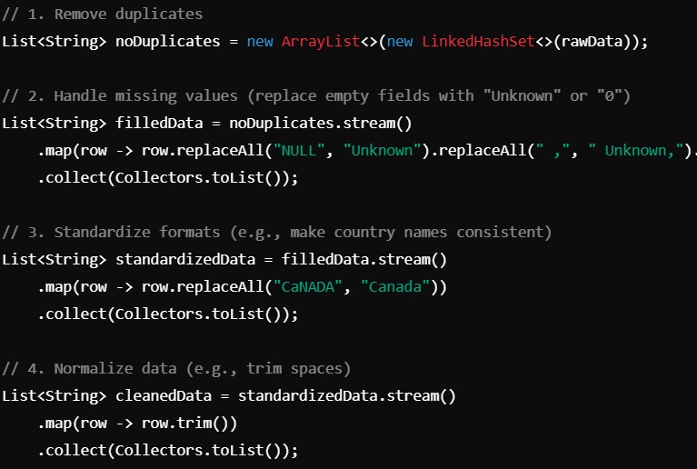
Techniques in Data Cleaning
1. Remove Duplicates
2. Handle Missing Values
3. Standardize Formats
4. Normalize Data
5. Data Transformation

Slide 7

Libraries for Data cleaning
Java supports the following Libraries:
Apache Commons CSV
OpenCSV
JSoup
Apache POI
Google Guava
Apache Spark ( with Java )

Slide 8



Challenges in
Data Cleaning
Time Intensive
Large Datasets
Inconsistent formats

Slide 9







Data Integration
Data integration is the process of combining data from multiple sources into a unified view, ensuring consistency, accuracy, and accessibility. It is a critical step in data preprocessing for analytics, data mining, and decision-making.

Slide 10




Techniques for Data Integration
Schema Matching
Entity Matching
Addressing Conflicts

Slide 11

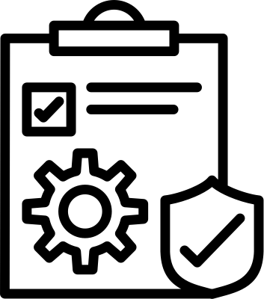


NAME COMPANY
OUR OFFERINGS
SERVICE ONE
SERVICE TWO
Elaborate on what you want to discuss.
Elaborate on what you want to discuss.
SERVICE THREE
SERVICE FOUR
Elaborate on what you want to discuss.
Elaborate on what you want to discuss.

Slide 12



Tools for Data Integration
Hibernate for ORM
JDBC for DB Connection

Slide 13

Real Time Integration with Apache Kafka
— Apache Kafka enables real-time data streaming, allowing us to integrate dynamic datasets efficiently in Java applications.

Slide 14


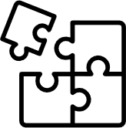

Challenges in
Data Integration
Scalability
Real Time Updates
Data Conflicts
DATA BREACHES

Slide 15


Data Selection
3rd Step In
Data Mining

Slide 16





Selection Criteria
Relevance
Significance
Coverage

Slide 17

Libraries for Selection
Apache Commons Collections
Streams API
Google Guava

Slide 18

Challenges in Data Selection
Identifying Relevant Criteria
Processing Large Datasets

Slide 19



Reduced Complexity
Benefits of Data Selection
Focused Analysis

Slide 20
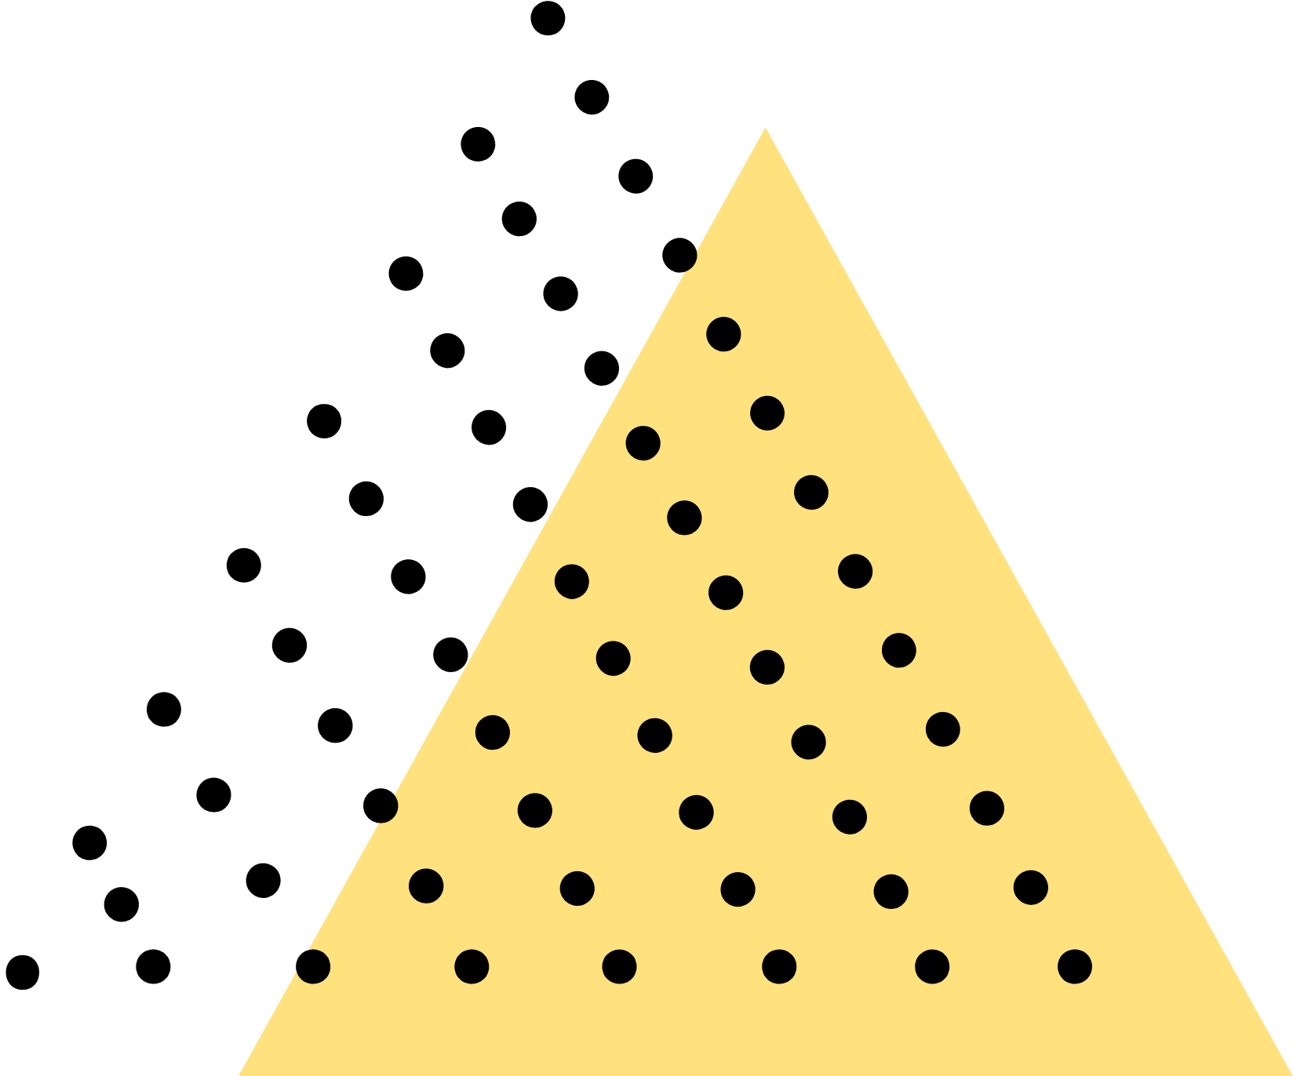







Data
Transformation
Data transformation refers to the process of converting data from one format, structure, or value to another. It's commonly used in tasks like data preprocessing, analysis, integration, and visualization.

Slide 21


Basic Data Transformation Techniques
Streams API
Apache Commons Lang

Slide 22
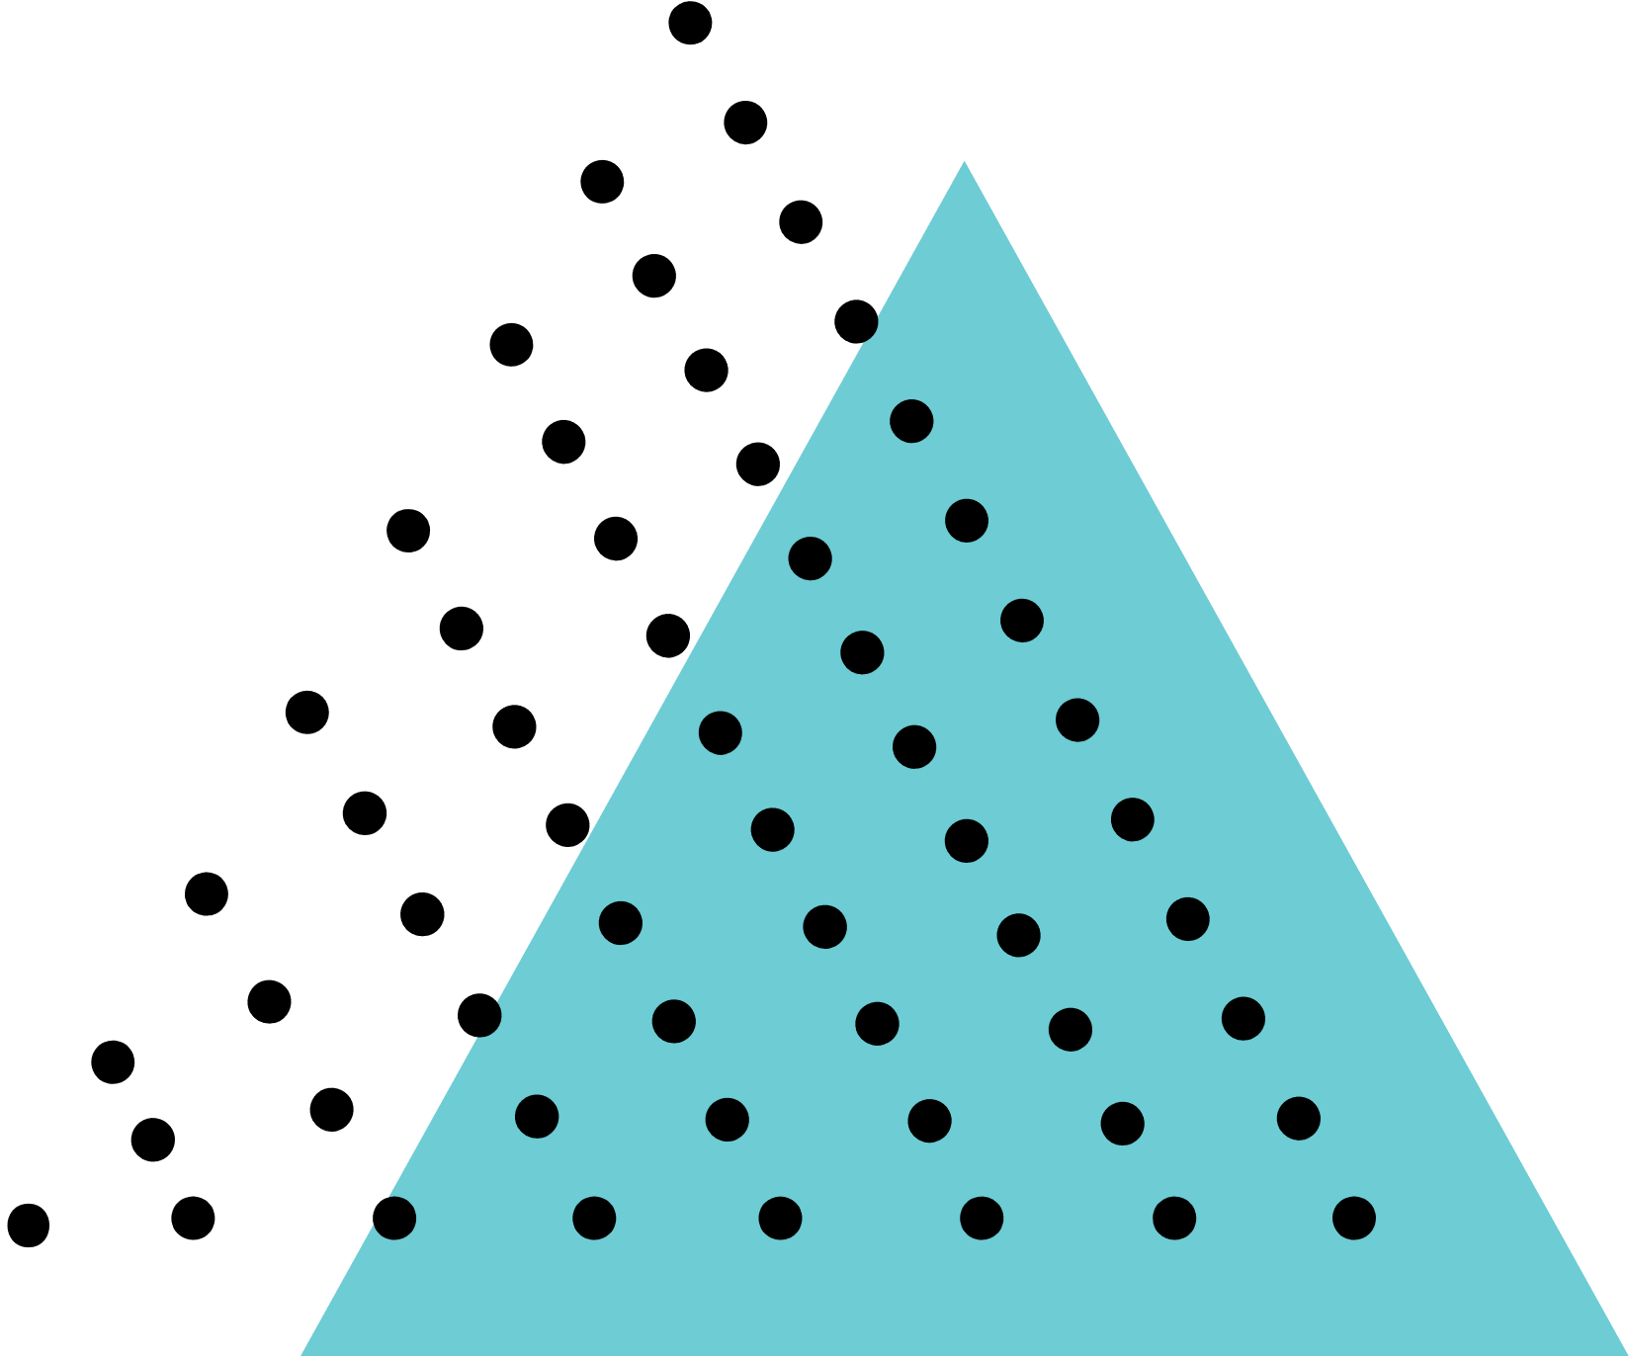

Libraries for Data Transformation
Apache POI
Jackson
GSon

Slide 23



Data Mining
Data mining involves analyzing large datasets to discover patterns, trends, and insights that are not immediately apparent. It uses statistical, mathematical, and machine learning techniques to extract useful information.

Slide 24
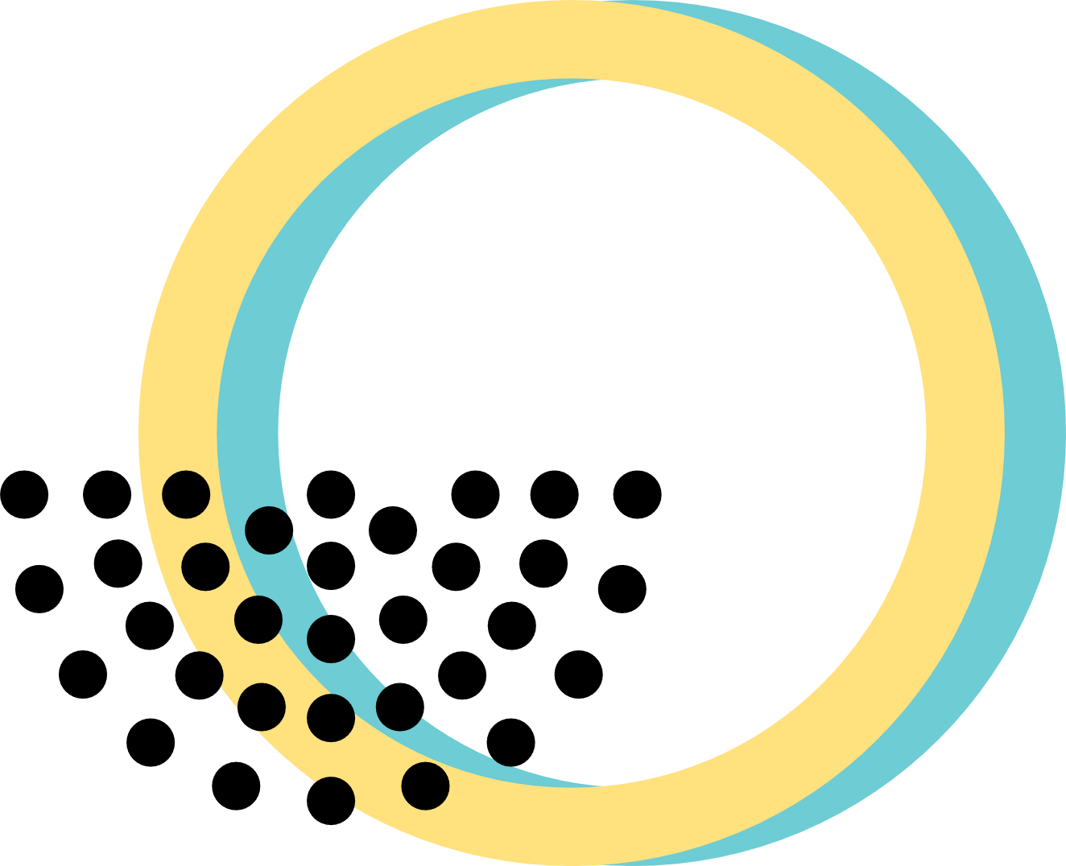

Key Steps in Data Mining
Data Collection
Data Preprocessing
Data Exploration
Modeling
Evaluation and Deployment

Slide 25

Key Techniques
In Data Mining
Anomaly
Detection
Text
Mining
Clustering
Regression

Slide 26

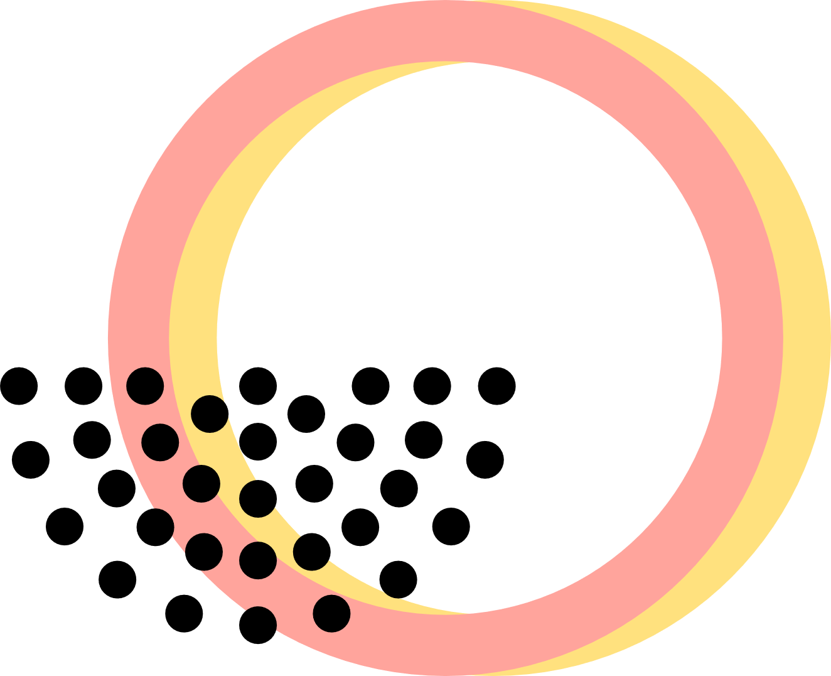
Libraries for
Data Mining
Apache Mahout
RapidMiner Java API

Slide 27

Evaluation Methods
1
Accuracy
2
Relevance
3
Visualization

Slide 28

Summary and Open Floor for Questions

Slide 29

Members of our Team
Vedha Vishal K 22MIY006
Tameem Ahmed S 22MIY004
MOH. Kaif Khan I 22MIY0009
Sujith S 22MIY0046
Arasu 22MIY0047
Hitesh Varshan B K 22MIY0048

Slide 30


Thank you
For your valuable Time
Scan code to download

